Slide 1


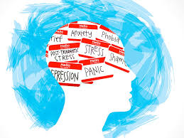
Mental Health Prediction Using Machine Learning
Guide name:Mrs.M R Nithya
Team Members:Arthy M(CB2207)
Reena S(CB2244)
Shree Harini S(CB2250)
Soundharya AL(CB2252)

Slide 2
Abstract
The national institute of mental health and neuro sciences, bengaluru, conducted a survey on mental health issues across 12 states in india, including punjab. The report revealed that 15% of indian adults require treatment for mental disorders. Machine learning, a subset of artificial intelligence, can play a crucial role in detecting mental illnesses. This study proposes using the decision tree classifier algorithm to identify mental health conditions like anxiety, depression, and stress by analyzing recorded datasets. The goal is to create a training model that can predict the target variable class. Additionally, the random forest algorithm is applied to predict mental illnesses, resulting in a more accurate prediction level compared to existing models. This research aims to provide an ideal solution for detecting mental health conditions using machine learning algorithms.

Slide 3

Introduction
Mental health prediction using machine learning is the process of using computer algorithms to analyze data and identify patterns that can help predict the onset or severity of mental health conditions like depression or anxiety.
This allows for earlier detection and more personalized treatment options.
Key Components
Data Collection
Feature Extraction
Machine Learning Models
Prediction and Monitoring

Slide 4
Problem Statement
Mental health issues like anxiety, depression, and stress affect many people, with 15% of Indian adults needing treatment, as found in a survey by NIMHANS. Traditional methods to diagnose these conditions can be slow and rely on subjective assessments.
This study aims to use machine learning, specifically Decision Tree and Random Forest algorithms, to analyze data and predict mental health conditions more accurately. The goal is to create a system that helps detect mental health problems early, improving diagnosis and treatment.

Slide 5
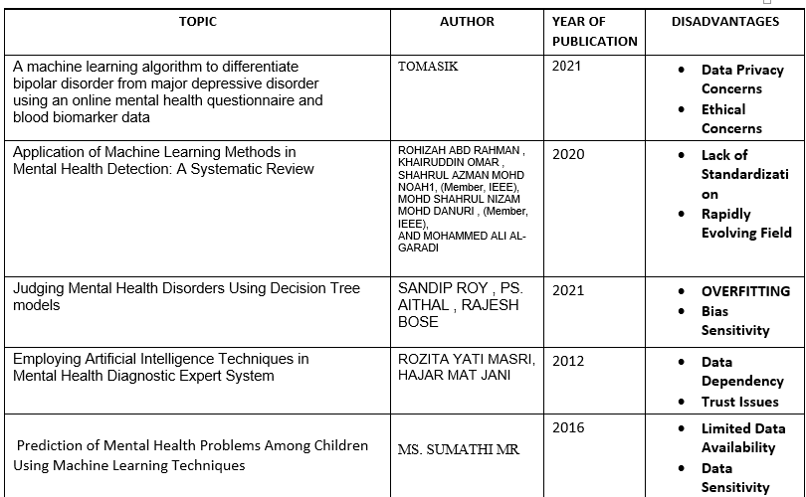
Literature review

Slide 6
Mental health prediction using ML existing System
1. PSYCHOSIS PREDICTION SYSTEM: Utilizes MRI scans and ML algorithms to predict psychosis onset.
2. Mental Health Screening Tool (MHST): Employs natural language processing (NLP) and ML to identify mental health risks.
3. Predictive Analytics for Mental Health (PAMH): Analyzes electronic health records (EHRs) to predict mental health outcomes.
4. Mental Health Forecast (MHF): Uses social media data and ML to predict depression and anxiety.
5. Clinical Decision Support System (CDSS): Integrates ML with EHRs to predict mental health diagnoses.

Slide 7
Disadvantages of existing system
Limited contextual understanding: ML models may not fully understand the complexities of human behavior, emotions, and social context.
Data quality issues: Poor data quality, bias, or incomplete information can lead to inaccurate predictions.
Patient privacy concerns: Using sensitive personal data for ML predictions raises privacy and confidentiality concerns.
Continuous updating and maintenance: ML models require regular updating and maintenance to ensure accuracy and relevance.
Regulatory and ethical challenges: There is a need for clear guidelines and regulations on developing and deploying ML-based mental health prediction systems.

Slide 8


